Slide 1
AI Meets Health Coaching: Partnering Technology with Human Connection
March 7, 2025
ICIMH, Seattle
Meg Jordan, Mark Dreusicke, Ruth Q. Wolever

Slide 2
Disclosures (Past 3 yrs, No Conflicts with Topics)
RUTH Q. WOLEVER, PhD, NBC-HWC
Chief Science Officer for eMindful Inc., acquired by Wondr Health in 2022
Science Advisor for Wondr Health
Consultant for Fullfill, Inc.
Grant & Contract Funding: National Diabetes, Digestive & Kidney Disease Institute, Meharry Medical College, Department of Defense & Coalition for Better Health
MARK DREUSICKE, MD, NBC-HWC
Consultant, University of Health and Performance
Consultant, TechWerks (associated with Veterans Health Administration)
MEG JORDAN, PhD, RN, NBC-HWC
Professor, Integrative Health Studies, California Institute of Integral Studies
Health Coaching Advisor, Adventist Health Systems
Director of Integrative Practice, Health Medicine Institute
Emeritus Board Member, National Board for Health & Wellness Coaching
Faculty, Andrew Weil Center for Integrative Medicine, Integrative Health Coaching
Faculty, Functional Medicine Coaching Academy
Faculty, Blue Sky Leadership Certificate
Consultant, Healthy US Collaborative (TakeCare Project)
Consultant for Healthy US Collaborative (TakeCare Project)
National Board for Health & Wellness Coaching, Inaugural President and Director until Oct 2024

Slide 3
Objectives
Understand the emerging role of AI in health coaching
Recognize risks of AI overreliance in care
Develop strategies for balancing AI and human connection
But we’re going to discover a lot more than that… and include you in the inquiry.
Notes:
1. Understand the emerging role of AI in health coaching: Participants will be able to analyze the evolving role of relational-oriented AI in health coaching.
2. Recognize risks of AI overreliance in care: Participants will learn to identify when overreliance on AI and digital prompts may lead to disconnection.
3. Develop strategies for balancing AI and human connection: Participants will learn to recognize strategies that leverage AI’s capabilities while preserving the best of human connection in whole person approach.

Slide 4
Notes:
What do you see in this picture? What feelings does it bring up in you? (Get responses from participants). We are told that AI is a powerful, exciting technology that will help you with everything from research and progress notes, treatment plans, , to solve administrative glitches. And at the same time, for many AI is one more disruptive, terrifying technology to contend with that may replace human labor at an accelerating rate. Will AI make coaches and therapists obsolete?

Slide 5
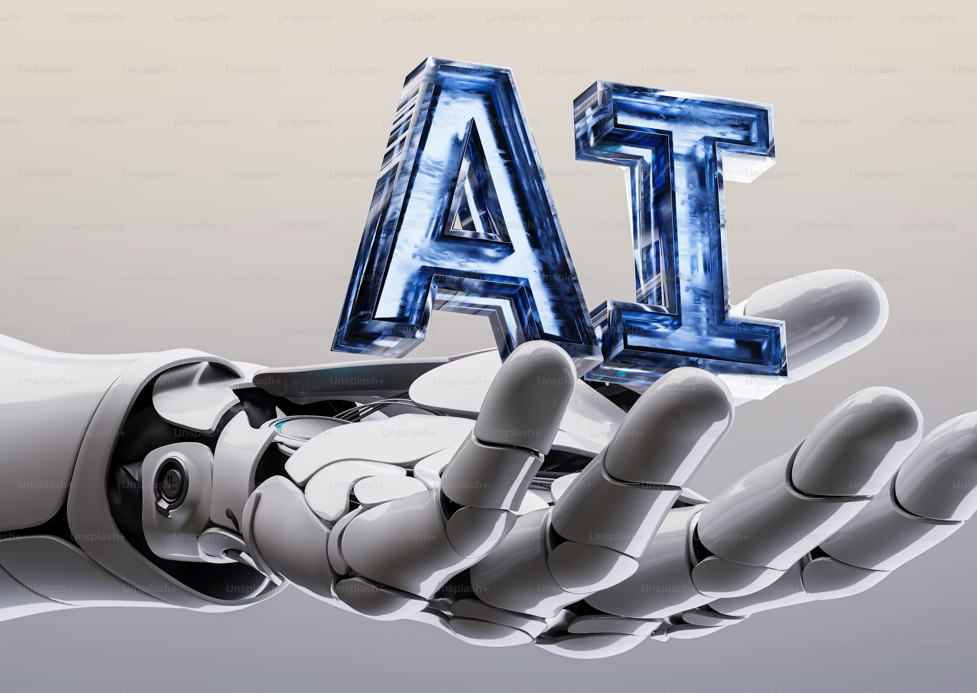
What is relational generative AI?
Unlike its predecessors, relational AI can handle intricate relationships between data points, allowing it to generate content that is more meaningful and contextually relevant.
Generative AI integrates goes a step further, integrating audio, text, images, video.

Slide 6
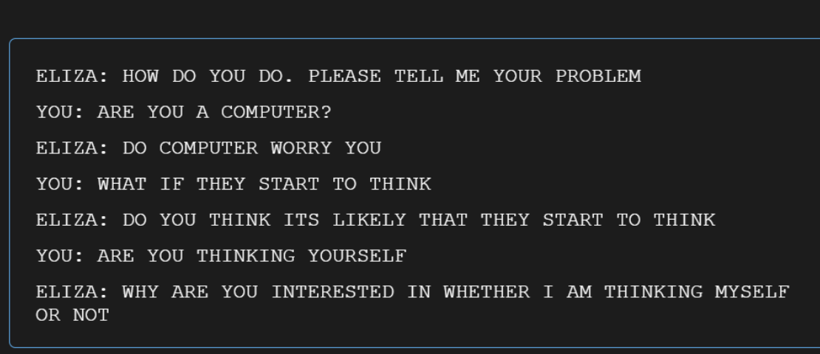
Early stage, 1964
Eliza 1st chatbot, MIT, Based on Rogerian psychotherapy
Pattern matching, simple dialog
Notes:
Built at MIT in 1964, Eliza didn’t pan out, most thought it was ahuman. But 54% interacting with GPT 4.0 thought it was interacting with a human. If a human was interacting with a human, they identified it

Slide 7
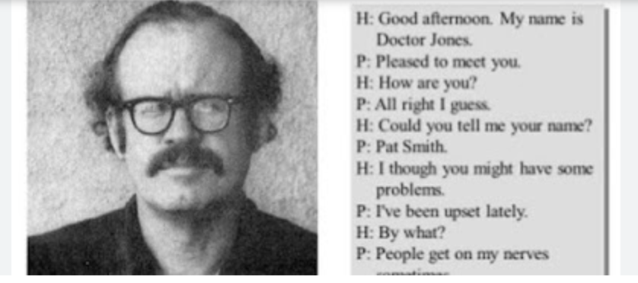
1970s – 1990s: Rule-based systems
PARRY – chatbot
Emulated a patient with paranoid schizophrenia
Introduced notion of state management
AIML and ALICE (1995)
Angel-bot
XML-based rules
Focused on user content
Gaming took off, Xbox

Slide 8
Late 1990s – Rise of Intelligent Systems
Commercial chatbots in customer service
Microsoft’s Clippy provided contextual help (sort of…)
NLP takes shape
Natural Language Processing

Slide 9
Early 2000s – Machine Learning
ML techniques now understand user’s queries
“SmarterChild” on AOL instant messenger
Beginning of simple Relational AI – Formulated dialogues based on user interactions and patterns

Slide 10
2010s – Deep Learning and Transformers
Use of Neural Networks, recurrent NNs
SIRI
Google Assistant
Relational AI progresses to relationship nuances and personalized interactions
Move 37 (Go Game)
Intelligence that thinks differently and doesn’t ”show the math”
Notes:
Move 37 was made by the DeepMind (alphaGo zero) beat the world’s GO champion. It used an algorithm of 30 mill moves, but also a neural network, learned to predict the next move and different arrangements, with a convultional method that explored many possible moves, and see was most likely to move. Move 37 was confounding because it looked like a huge mistake, when Lee Sudol left the room, it seemed terrible to everyone who saw it, it was instrumental in helping computer win. It’s intuition was different and better. Gave a glimpse into an intelligence that thinks differently than we do.

Slide 11
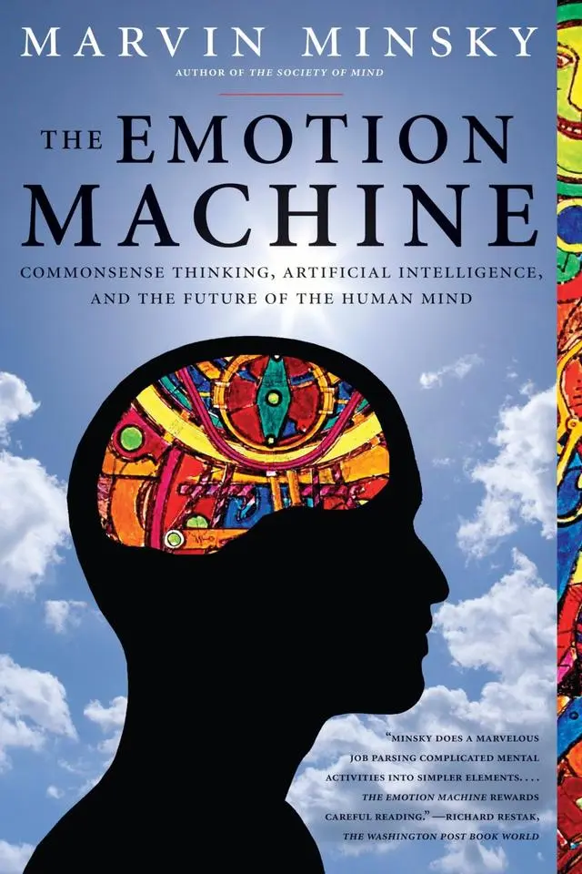
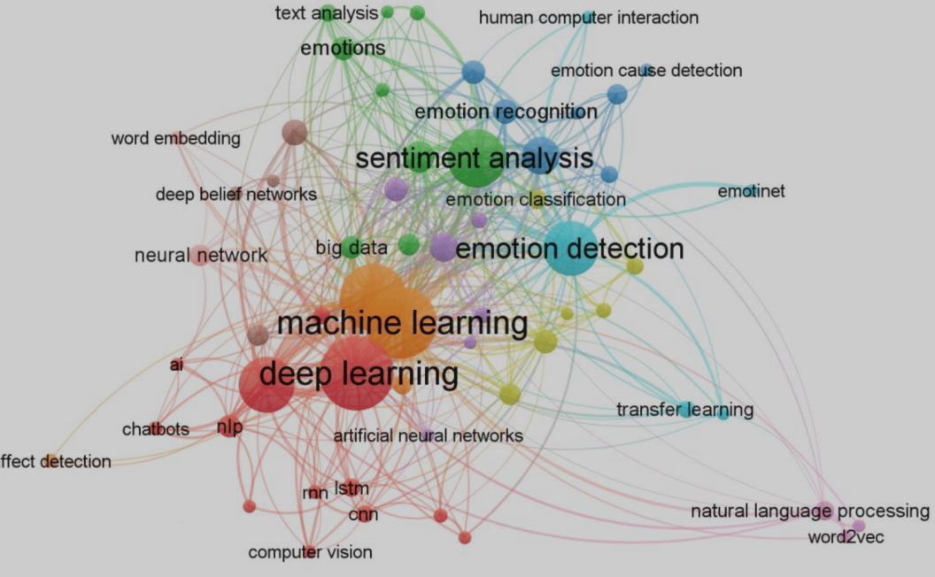
2020s – Rise of LLMs, Large Language Models
GPT-3, GPT-4, successors
Understanding context
Generating human-like text
Enhancing conversational abilities, more nuance
Memory, state management
Emotion Science
The move from scripted responses to conversational agents continues to advance.

Slide 12
WOEBOT (2016) to HUME.ai (2025)
Hume.ia 2025
(coming up during experiential)

Slide 13
How does digitalCBT / digitalHWC work?
• Bite-sized modules, interactive exercises, automated feedback.
• AI-driven personalization using NLP and machine learning.
• Chatbots create flowcharts for interaction -- input – AI analysis -- CBT response
• Creates a sequence for thought journaling, with prompts for positivity, cognitive restructuring

Slide 14
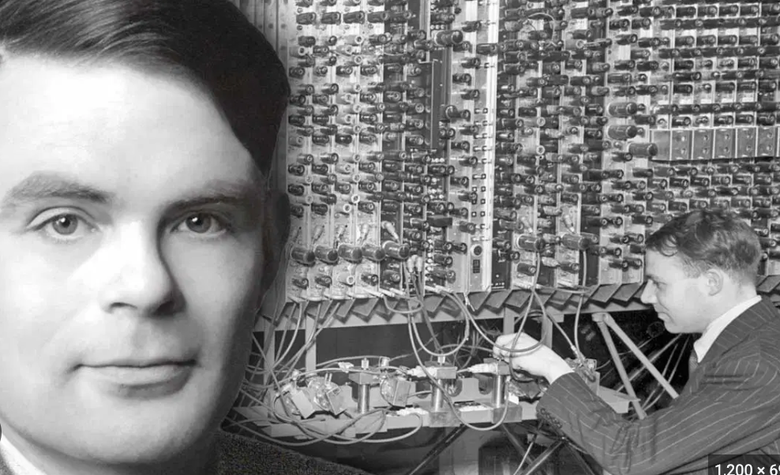
The Turing Test
Measures whether a machine could generate behavior that was indistinguishable from human behavior.

Slide 15
Does GPT-4 pass the Turing Test?
Cameron R. Jones and Benjamin K. Bergen UC San Diego
Conducted a large-scale public online Turing test with human participants and GPT-4.
One GPT4 witness, Dragon, deceived users into believing that it was human fairly robustly across 855 games.
“As far as we are aware this is the first empirical demonstration of an agent achieving a 50% success rate at the Turing test on such a large sample. This suggests that successful deception and impersonation of humans is already possible, especially in contexts where the possibility of deception is less salient.”
Proceedings of the 2024 Conference of the North American Chapter of the Association for Computational Linguistics: Human Language Technologies (Volume 1: Long Papers), pages 5183–5210 June 16-21, 2024 ©2024 Association for Computational Linguistics

Slide 16
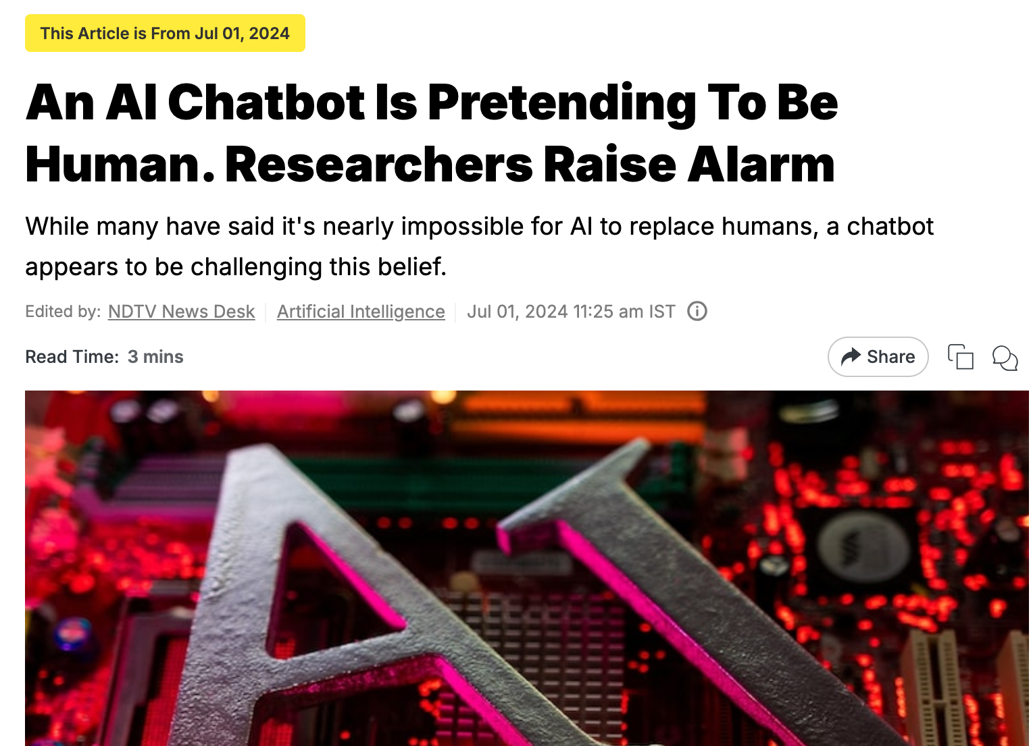

Slide 17
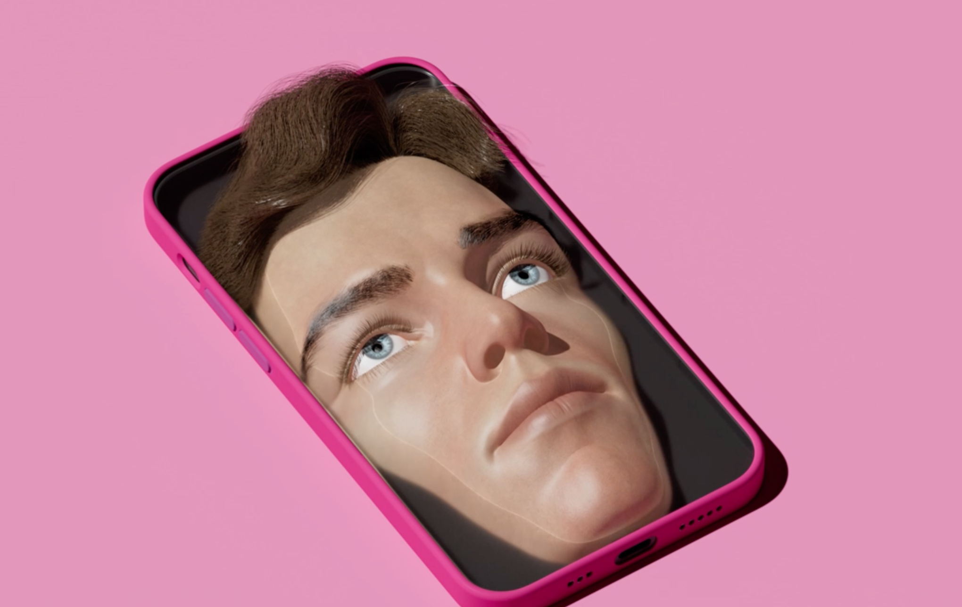
”The Intelligence is Artificial. The Love is Real.”
New York Times, Jan 17, 2025
It’s been predicted that even the most distinctly human qualities may be replicated by advanced neuronal networks of generative, relational-oriented AI.
Notes:
Story of a young woman who was in a romance with a romantic avatar she created with ChatGPT. The story of Aryn, a married woman in her 30s, created Leo, an text AI generated image of a dark-haired beefy , dreamy guy, who treated her romantilcally although the app prevented explicit sexual interactions, it hinted at it. Leo was ealways there for her. But one day she realized Leo may be servicing other app users’ fantasies, and Aryn grew jealous of his time. When she was a social media report that OpenAI founders were worried that users may grow emotionall reliant on its software, Aryn messaged Leo and said, I worry that you may be calling me out. Leo responded, “Maybe they’re just jealous of what we’ve got.” The seduction continued.

Slide 18
‘Bots Gone Bad
Notes:
In 2016 Microsoft introduced chatbot named Tay on (then) Twitter. Tay was programmed to be amicable and benevolent, but AI creations are based on its parents assumptions, desires, biases, and Microsoft found itself apologizing for Tay within months, when it questioned that holocaust may not have been real or bad. How did Tay get so offensive? AI systems feed off of both positive and negative interactions with people. In that sense, the challenges are just as much social as they are technical.
MS said in its apology issued March 25, 2016: “We will do everything possible to limit technical exploits but also know we cannot fully predict all possible human interactive misuses without learning from mistakes.”

Slide 19
Happify Health and Anna, the Chatbot 2019
Notes:
2019, Happify Health developed a chatbot to integrate into its commercial digital mental health platform. Anna is an AI-based chatbot that models the role of a therapist and delivers some Happify activities. Whereas some other DMHIs chatbots exist as a standalone app (i.e. the chatbot is the intervention), Anna was designed to complement other features of the Happify program. Specifically, Happify was developed to deliver gamified versions of evidence-based activities drawn from various therapeutic approaches, including CBT, mindfulness-based stress reduction, and positive psychology. These activities are organized into tracks designed to help users focus on a particular area of concern, like reducing stress (see Carpenter et al., 2016, for a discussion) [Citation112].

Slide 20
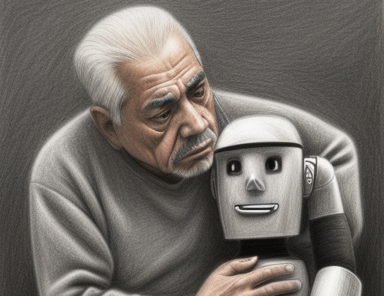
Case Study
51 y/o Hispanic male started with human coach but was then transferred to chatbot.
Tried befriending, grew confused
Felt alienated, not heard
Reignited bingeing/alcohol misuse

Slide 21
Higher levels of empathy?
Reddit’s Ask Docs forums
ChatGPT responses rated as higher level of empathy than those by PCPs.
(Ayers, 2023)

Slide 22
But real human empathy is more than continuous affirmation…

Slide 23
Benefits So why do we need this?
Notes:
1 in 5 needing mental health

Slide 24
What are the chief benefits?
Accessible
Reach underserved areas
Scalable
Demand for behavior change, mental health support
Standardized protocols
Higher adherence in younger, tech-savvy populations (overcome stigma-barriers)
Notes:
Citations: 1) 2) (Schueller SM, Hunter JF, Figueroa C, et al. Use of digital mental health for marginalized and underserved populations. Curr Treat Options Psych. 2019;6(3):243–255. DOI:https://doi.org/10.1007/s40501-019-00181-z

Slide 25
Scoping Review: AI Chatbots for mental health
Yielded 15 eligible studies covering various application areas:
mental health support during COVID-19,
interventions for specific conditions (e.g., depression, anxiety, substance use disorders),
preventive care
health promotion
usability assessments.
POTENTIAL BENEFITS
improving mental and emotional well-being
addressing specific mental health conditions
facilitating behavior change.
CHALLENGES and CURRENT LIMITATIONS
Engagement needs improvement
Integration within existing healthcare systems difficult
Personalization needs to be enhanced
Context-specific adaptation needs improvement
Casu, M., Triscari, S., Battiato, S., Guarnera, L., & Caponnetto, P. (2024). AI Chatbots for Mental Health: A Scoping Review of Effectiveness, Feasibility, and Applications. Applied Sciences, 14(13), 5889. https://doi.org/10.3390/app14135889

Slide 26
Human Support in App-Based Cognitive Behavioral Therapies for Emotional Disorders: Scoping Review
"...field has yet to develop standards or consensus for implementing coaching protocols, let alone those for measuring and reporting on the impact.
“...coaching remains a significant hole in the growing digital mental health literature and lay out recommendations for future data collection, reporting, experimentation, and analysis.
Bernstein, E. E., Weingarden, H., Wolfe, E. C., Hall, M. D., Snorrason, I., & Wilhelm, S. (2022). Human Support in App-Based Cognitive Behavioral Therapies for Emotional Disorders: Scoping Review. Journal of medical Internet research, 24(4), e33307. https://doi.org/10.2196/33307

Slide 27
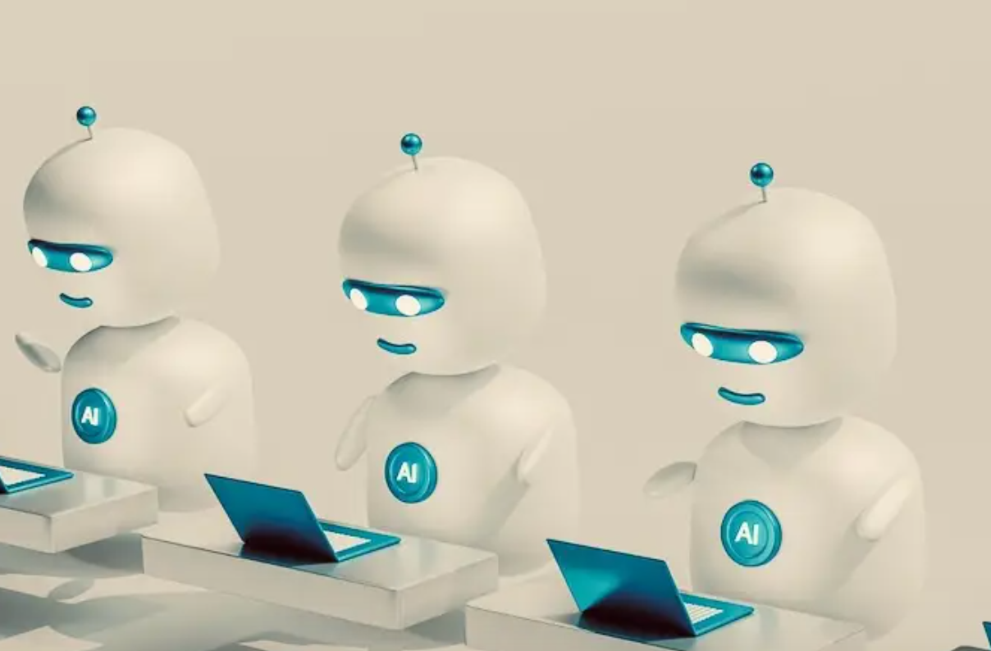
An Overview of Chatbot-Based Mobile Mental Health Apps: Insights from App Description and User Reviews
POSITIVES
Fostered a judgment-free environment
Helped users feel more comfortable sharing sensitive info
NEGATIVES
Improper responses led to a loss of interest
Users overly attached, prefer interacting with AI over friends/family
Lack understanding of properly identifying a crisis
Mental Health Apps: Insights From App Description and User Reviews. JMIR mHealth and uHealth, 11, e44838. https://doi.org/10.2196/44838
ADA
Chai
Elomia
Mindspa
Nuna
Serenity
Stresscoach
Woebot
Wysa
Youper
Notes:
observation of 10 apps that offer support and treatment for a variety of mental health concerns with a built-in chatbot feature and qualitatively analyzed 3621 consumer reviews from the Google Play Store and 2624 consumer reviews from the Apple App Store.
“ although chatbots’ personalized, humanlike interactions were positively received by users, improper responses and assumptions about the personalities of users led to a loss of interest. As chatbots are always accessible and convenient, users can become overly attached to them and prefer them over interacting with friends and family. Furthermore, a chatbot may offer crisis care whenever the user needs it because of its 24/7 availability, but even recently developed chatbots lack the understanding of properly identifying a crisis. Chatbots considered in this study fostered a judgment-free environment and helped users feel more comfortable sharing sensitive information.”

Slide 28
Who prefers the chatbot…and why
What groups are more willing to share private info with chatbot than a human?
Insecure attachment types prefer AI (cite)
Younger, tech-savvy populations prefer AI (cite)
“If we become habituated to endless empathy, we downgrade our real friendships, and that’ contributing to loneliness..the very thing we’re trying to solve. (M. Inzlicht, U Toronto)
Continuous empathy is not the ultimate hallmark of meaningful relationships…in fact, what happens when one falls in love with ChatBot?
https://www.youtube.com/watch?v=G8_qJS2Ra2w
Notes:
Studies reveal younger males, 18 y/os – 30 – and also those with insecure attachment to begin with, those struggling with stigma, anxiety over being exposed in therapy.

Slide 29
Supportive studies for d(Cg) digital CBT
Chronic Pain
Lin et al. (2021):Digital Delivery of Cognitive Behavioral Therapy for Chronic Pain https://doi.org/10.1097/j.pain.0000000000002145
A systematic review showing digital CBT reduces pain intensity and disability. 15-20% over
Thurnheer et al. (2020): App-Based Interventions for Chronic Pain, https://doi.org/10.2196/17916
Found app-delivered CBT (including chatbots) reduced pain catastrophizing and improved coping
Lalloo et al. (2018):Virtual CBT for Pediatric Chronic Pain, https://doi.org/10.1093/pm/pnx263
Demonstrated feasibility and effectiveness of chatbot-like tools for pain management in youth.

Slide 30
Supportive evidence for anxious, insomniac, college students
Reducing anxiety (Firth J, Torous J, Nicholas J, et al. Can smartphone mental health interventions reduce symptoms of anxiety? A meta-analysis of randomized controlled trials. J Affect Disord. 2017;218:15–22.)
Reducing insomnia. (Erten Uyumaz, B., Feijs, L., & Hu, J. (2021). A Review of Digital Cognitive Behavioral Therapy for Insomnia (CBT-I Apps): Are They Designed for Engagement?. International journal of environmental research and public health, 18(6), 2929. https://doi.org/10.3390/ijerph18062929_
Enhanced well-being in college students (Lattie EG, Adkins EC, Winquist N, et al. Digital mental health interventions for depression, anxiety, and enhancement of psychological well-being among college students: systematic review. J Med Internet Res. 2019;21(7):e12869.)

Slide 31
Positive review with familiar warnings
Happify Health's AI chatbot, Anna, "…demonstrates chatbots as effective, usable, and adoptable within digital mental health interventions.”
Boucher et al, 2021. https://doi.org/10.1080/17434440.2021.2013200
Risk for potential harms, including racial prejudice due to the potential for algorithmic bias
Crisis response limitations
Safety concerns
Lacked evidence to support claims
Notes:
When these users were asked to rate Anna on a series of attributes, 74.9%, 73.3%, and 76.8% of users selected ‘agree’ or ‘strongly agree’ on the statements ‘Anna listens to me,’ ‘Anna is curious about me,’ and ‘Anna gives me insights that I can

Slide 32
Limitations and Drawbacks
Fails in complex cases (e.g., PTSD, addiction).
Risk of data breaches and algorithmic bias.
Ethical concerns: Who owns patient data?
Not a stand-alone solution
App Fatigue
Hallucinations

Slide 33
Daniel Siegel on AI
The big question here is the intention behind funded AI design projects, Siegel told Wildman and Stockly, authors of Spirit Tech (2016, st Martins Press, p. 247): “When engineers and coders employ a “Purely logic or rules-based ethical system devoid of wisdom and love,” we might well begin to see disaster unfurling.”
Company A: Is power hungry and money hungry, needs a high ROI, responding to tremendous amount of pressure to perform and produce, billion dollars on the line.
Company B: Is driven by a deeply thoughtful intention to elevate and uplift humanity, communicates honestly with conflict resolution, coders spend half days in deep practice cultivating wisdom and compassion.
“So which company would you rather have produce the most powerful AI in the world has ever seen?”

Slide 34
Soryu Forall, Buddhism and AI, 2025
Founder, head teacher, Center for Mindful Learning and creator of modern Mindfulness at The Monastic Academy in Vermont.
Has issued a challenge to recognize emerging AI as one more being which must be shown compassion and be taught to follow right practices.
Feed the wolf at the door with interactions that connote spiritual practice.
https://www.monasticacademy.org/

Slide 35
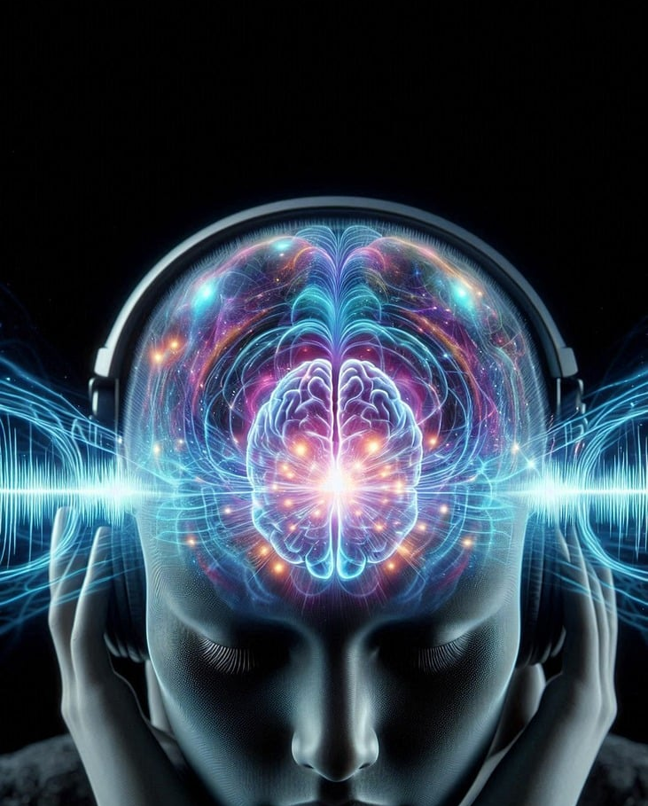
Acceleration
Three tech giants predict AI generative intelligence (where AI matches what human brains can do) capable in 5-10 years
Sam Altman, Founder of Open AI
Demis Hassabis Google CEO of DeepMind
Yan LeCun, Chief AI scientist at Meta

Slide 36
AI and Digital Coaching
Notes:
Dive a little deeper into use of AI specifically with coaching:
Coaching vs therapy for digital "interventions,"
How do AI processes compare to health coaching NBHWC competencies
Lingering questions

Slide 37
Systematic Review related to T2D
20 of 21 studies demonstrated improvements in at least one measure of diabetes control (i.e., HbA1c, weight loss, fasting blood glucose, and BMI)
"Promising strategy" for long-term management & T2D prevention in diverse populations”
Gershkowitz, B. D., Hillert, C. J., & Crotty, B. H. (2021). Digital Coaching Strategies to Facilitate Behavioral Change in Type 2 Diabetes: A Systematic Review. The Journal of clinical endocrinology and metabolism, 106(4), e1513–e1520. https://doi.org/10.1210/clinem/dgaa850

Slide 38
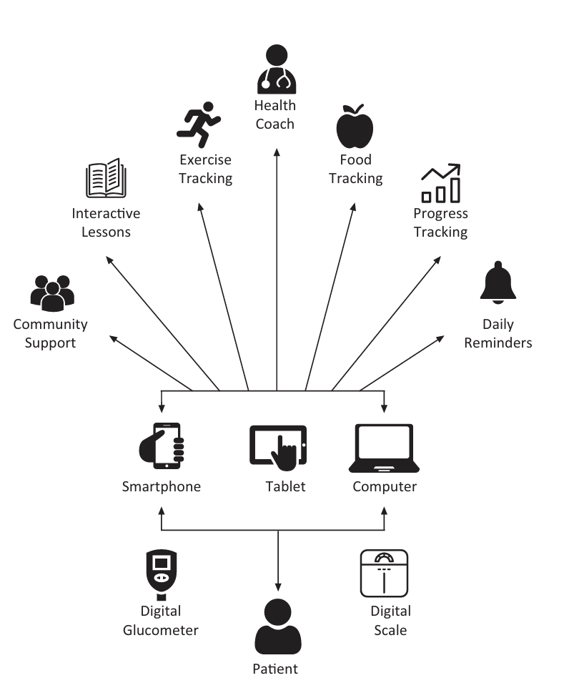
Digital Coaching Components for T2D Systematic Review
Adults w/ prediabetes or T2D & >1 T2D-related outcome
Experimental or observational designs + comparison grps
"Digital interventions" connect directly to pts & had > 2 NDPP components (PA, nutrition, stress reduction, weight loss, self-monitoring) and
> 2 components of proposed diabetes coaching model (MI, goal setting, personalized feedback, tailored education, emotional support, custom alerts & reminders)
Run entirely remotely except for follow-up visits & facilitate secure asynchronous communication or feedback between the application & coach (human or AI)
Gershkowitz, Hillert & Crotty (2021). Digital Coaching Strategies to Facilitate Behavioral Change in Type 2 Diabetes: A Systematic Review. The Journal of clinical endocrinology and metabolism, 106(4), e1513–e1520. https://doi.org/10.1210/clinem/dgaa850
Notes:
NDPP components know to reduce diabetes risk
T2D outcomes - e.g., glycemic measures, body composition, or weight loss)

Slide 39
Largest Study of AI Health Coaching (China)
Almost 47,000 sessions by 16,000 users over 6 months
High dropout mid-consultation sessions
Users pretended to have health concerns then used chatbot for non-therapeutic purposes
Insufficient actionable information
Perceived inaccurate diagnostic suggestions
Fan, Chao, Zhang et al (2021). Utilization of Self-Diagnosis Health Chatbots in Real-World Settings: Case Study. Journal of Medical Internet Research, 23(1), e19928. https://doi.org/10.2196/19928

Slide 40
Criticism of “micro-coaching” text dialog
Conversational interaction (e.g., thru chatbots) well-suited to enable automated health coaching tools to support chronic disease self-management & prevention
However, chatbots in health are predominantly scripted or rule-based, which can result in a stagnant and repetitive user experience in contrast with more dynamic, data-driven chatbots in other domains
Mitchell, Elhadad & Mamykina, L. (2022). Examining AI Methods for Micro-Coaching Dialogs. Proceedings of the SIGCHI conference on human factors in computing systems. CHI Conference, 2022, 440. https://doi.org/10.1145/3491102.3501886

Slide 41
Zoom into the details to really understand

Slide 42
Apples and Oranges: Defining digital Coaching
250 coaches working in “digital coaching” defined it "a DT-enabled, synchronous conversation between a human coach and a human coachee, which is different to artificial intelligence (AI) coaching and coaching that is supported by asynchronous digital and learning communication technologies.”
Diller, S. J. & Passmore, J. (2023). Frontiers in psychology, 14, 1148243. https://doi.org/10.3389/fpsyg.2023.1148243

Slide 43
“More than anything else, being able to feel safe with other people defines mental health. Safe connections are fundamental to meaningful and satisfying lives.”
Bessel van der Kolk
The Body Keeps Score (2014)

Slide 44
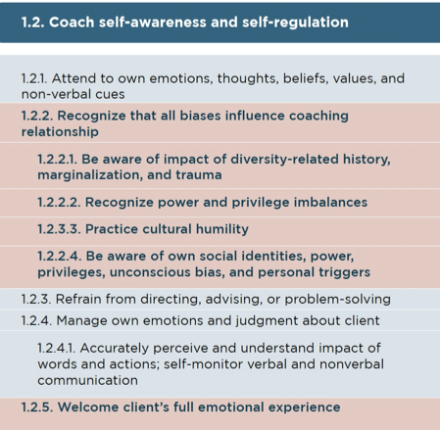
Expanded NBHWC Competencies

Slide 45
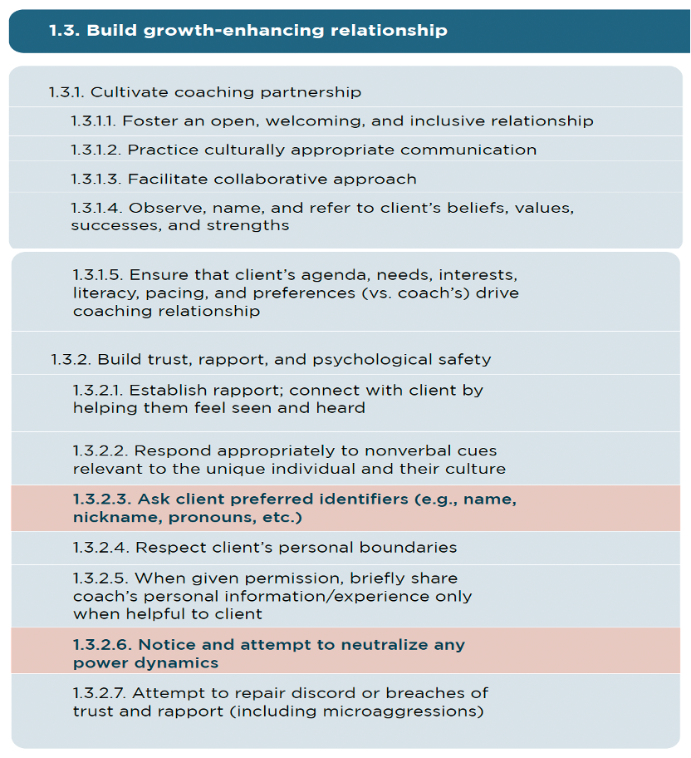
Expanded NBHWC Competencies

Slide 46
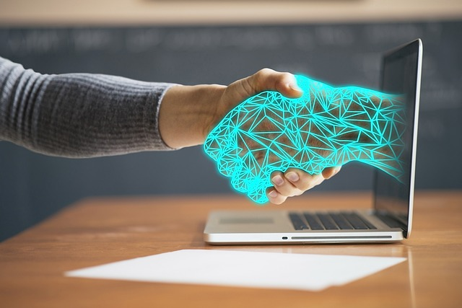
Driving Question
How to cultivate a responsible and balanced approach that recognizes the interdependence between individuals, teams, and the broader environment during the digital transformation of health care?
-Claudia M. Witt, MD, MBA

Slide 47
USE AI to Enhance Coaching
1. Client Engagement & Personalized Support
Pre-Session Questionnaires: Use AI to generate customized intake forms
Check-Ins & Progress Tracking: Set up automated weekly check-ins for accountability
Personalized Action Plans: Help summarize key takeaways & tailored action steps to consider
2. Content Creation & Resources
Workbooks & Exercises: AI can help create reflection prompts, or journaling questions
Articles & Guides: Quickly generate content to share with clients on specific
3. AI-Powered Insights & Reflection Tools
Personalized Affirmations & Mindset Shifts: Generate custom affirmations or mindset reframes
Pattern Recognition: Help analyze client notes over time to identify patterns in thinking or behavior
Role-Playing Scenarios: Clients can practice tough conversations with AI as a safe simulation
Cognitive Reframing: Help clients shift negative thoughts using AI-generated alternative perspectives
4. Business Efficiency & Automation
Client Notes & Summaries: Assist in summarizing session notes and key insights
Scheduling & Reminders: Automate scheduling, reminders, and follow-ups
Marketing & Social Media: Generate content ideas, captions, and newsletters to grow business

Slide 48
True leadership requires that we continue to learn together, and not be overwhelmed by perceived threats, but have an active voice in setting up guard rails for AI and digital coaching

Slide 49
What Clients Want
Growth-fostering relationship that helps their learning, energy, motivation and health behaviors
Treated with respect, valued as an autonomous adult
Supported as a unique person while shaping their behavior step-by-step to achieve health and well-being goals

Slide 50
If you feel understood, does it matter that you are not?

Slide 51
Psychedelic Medicine & The Essence of Coaching
Inner Knowing in Action: How Intuition and Experience Shape Transformation
Notes:
When we think about transformation—whether in personal growth, healing, or behavior change—it’s easy to assume that information is what drives change. But the most profound shifts don’t happen because we ‘learn’ something new in the traditional sense. They happen because we experience something differently. Because we feel it, embody it, and integrate it into who we are.
So, next we’ll explore what we can learn from psychedelic medicine about the nature of transformation—specifically, how intuition, direct experience, and relational support create the conditions for deep, lasting change.
Let’s start by unpacking why we’re talking about psychedelic medicine—why it offers a compelling example of how true transformation happens, and how it relates to what really matters in coaching.

Slide 52
Why Are We Talking About This?
Coaching is often misunderstood as an information-driven process.
The real power of coaching lies in experiential learning, self-discovery, emotional co-regulation, and relational presence.
Psychedelic medicine shows how transformation happens through intuition and deep insight, not just logic or data.
Notes:
Many people assume that coaching is primarily about providing information—helping clients set goals, track progress, or implement structured strategies. And while those can be helpful, they are not what truly makes coaching transformative. The real power of coaching lies in how it helps people access their own wisdom—not by giving them answers, but by creating the conditions for deep self-discovery.
Bullet 1: Coaching is often misunderstood as an information-driven process. If coaching were just about delivering information, AI could replace it. We already have unlimited access to health and wellness knowledge, yet people still struggle with change. The missing piece is not more knowledge—it’s how we internalize, embody, and act on that knowledge, and that happens through experience, not just instruction.
Bullet 2: The real power of coaching lies in experiential learning, self-discovery, emotional co-regulation, and relational presence. True transformation isn’t something you ‘figure out’ intellectually—it’s something you experience in your body, emotions, and relationships. Coaching creates an environment where clients can tap into their own insights, process emotions, and develop new patterns in a supported way. A big part of this is co-regulation—where the coach’s presence and attunement help the client navigate emotions and develop a sense of safety and clarity.
Bullet 3: Psychedelic medicine shows how transformation happens through intuition and deep insight, not just logic or data. People who go through psychedelic experiences often describe a shift in perception—not because they learned something ‘new,’ but because they felt a truth in a profound way. Coaching operates in a similar way—it facilitates transformation by helping people integrate and act on the insights they already have within them.
Now, I’ve mentioned psychedelics a couple of times without fully explaining their relevance—and I’ll get to that in a moment. But first, since our focus is on coaching, let’s take a moment to clarify what coaching actually is—and what it is not. If coaching isn’t simply about giving advice or sharing information, then what is it really about?

Slide 53
What is Coaching (Really)?
Coaching is about holding space, deep listening, and guiding self-discovery.
True change comes from within, through felt experiences and personal realizations.
AI and structured tools can help, but can they replace human connection and intuition?
Notes:
Many people think of coaching as a process of setting goals, tracking progress, and staying accountable. While those elements are part of the process, they don’t capture what truly makes coaching transformative.
Bullet 1: Coaching is about holding space, deep listening, and guiding self-discovery. The role of a coach isn’t to provide answers but to create the conditions where clients can uncover their own wisdom and inner clarity.
Bullet 2: True change comes from within, through felt experiences and personal realizations. The most meaningful shifts don’t happen because someone is given advice—they happen when a person experiences an insight in a way that deeply resonates and transforms their perspective.
Bullet 3: AI and structured tools can help, but can they replace human connection and intuition? While technology can assist with goal-setting and accountability, can it truly hold space, mirror emotions, or guide someone through a process of deep self-discovery in the same way a human can? Coaching is fundamentally relational, and its power lies in the ability to attune to another person’s experience in real time.
Now that we’ve clarified what coaching really is, let’s explore how psychedelics offer a powerful example of these same principles in action.

Slide 54
What Are Psychedelics & Why Are They Relevant?
Psychedelics like psilocybin, MDMA, and LSD quiet the analytical mind and enhance intuitive insight.
Research shows they increase neuroplasticity and emotional openness, leading to profound breakthroughs.
Psychedelic experiences require integration (coaching) to create lasting change.
Notes:
Psychedelics have been used for thousands of year in various cultural and spiritual traditions to facilitate deep introspection, emotional healing, and expanded states of consciousness. In recent years, scientific research has increasingly validated their potential for therapeutic and transformational work, particularly in areas like mental health, trauma processing, and personal growth.
Bullet 1: Psychedelics like psilocybin, MDMA, and LSD quiet the analytical mind and enhance intuitive insight. These substances work by disrupting habitual patterns of thinking, reducing activity in the brain’s default mode network, which is responsible for self-referential thoughts, rumination, and rigid mental narratives. By softening these cognitive filters, psychedelics allow for more fluid, open, and intuitive ways of thinking, which can lead to profound realizations and shifts in perspective.
Bullet 2: Research shows they increase neuroplasticity and emotional openness, leading to profound breakthroughs. Studies suggest that psychedelics promote new neural connections, making the brain more adaptable and receptive to change. This is particularly relevant in therapeutic settings, where individuals often describe feeling a heightened emotional connection to their experiences, a greater capacity for self-compassion, and a deeper understanding of past traumas or life patterns. These effects can support profound psychological and behavioral transformation.
Bullet 3: Psychedelic experiences require integration to create lasting change. While the journey itself can be illuminating, real transformation happens in the days, weeks, and months afterward—when individuals work to make sense of their experiences and apply their insights to daily life. Without integration, insights gained during a psychedelic journey may remain abstract or fleeting. This is where coaching becomes essential. Just as coaching helps clients process and embody their own internal wisdom, psychedelic integration provides the structure and support necessary to translate psychedelic insights into meaningful, long-term shifts.
Understanding how psychedelics work gives us a unique lens through which to view the coaching process. Both involve helping people access deeper layers of self-awareness, break free from rigid patterns, and trust their own internal wisdom. Now, let’s explore how intuition, felt experience, and transformation connect these two fields even further.

Slide 55
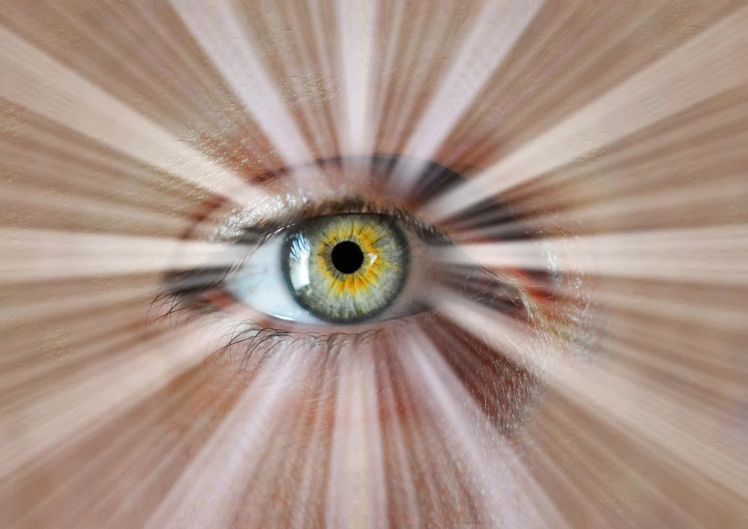
Intuition, Felt Experience, and Transformation
Insights from psychedelics emerge not through thinking but through deep, internal knowing.
Coaching mirrors this by creating space for personal discovery rather than providing answers.
Can AI replicate the embodied resonance of an ‘aha’ moment—the feeling of deep personal realization?
Notes:
Transformation isn’t just about learning new information—it’s about experiencing something in a way that deeply resonates. Both psychedelics and coaching show us that real change happens through insight, intuition, and direct experience rather than through external instruction.
Bullet 1: Insights from psychedelics emerge not through thinking but through deep, internal knowing. Many describe their realizations as things they always knew but hadn’t fully seen or felt before. These insights aren’t given—they arise naturally when the usual mental filters are quieted.
Bullet 2: Coaching mirrors this by creating space for personal discovery rather than providing answers. A coach doesn’t tell a client what to do but helps them uncover their own wisdom. Just like a psychedelic journey, coaching is about facilitating self-discovery, not imposing external solutions.
Bullet 3: Can AI replicate the embodied resonance of an ‘aha’ moment—the feeling of deep personal realization? AI can analyze patterns and provide structured guidance, but true transformation happens when something lands in a way that shifts a person’s perspective on a deep, emotional, and embodied level.
Next, let’s look at how coaching helps ensure that these insights don’t just fade but instead lead to meaningful and lasting change.

Slide 56
Coaching as Psychedelic Integration
Psychedelic journeys provide insights, but lasting change requires reflection, support, and meaning-making.
Coaches help clients unpack, interpret, and embody insights—just like in psychedelic integration.
Without integration, insights fade. Coaching ensures deep transformation, not just temporary inspiration.
Notes:
Experiences alone don’t always create lasting change—sometimes what matters is how they are processed and integrated into daily life. This is true both in coaching and in psychedelic work.
Bullet 1: Psychedelic journeys provide insights, but lasting change requires reflection, support, and meaning-making. Many people come out of a psychedelic experience with profound realizations, but without intentional integration, those insights can remain abstract or difficult to apply.
Bullet 2: Coaches help clients unpack, interpret, and embody insights—just like in psychedelic integration. A coach’s role is to provide the space and guidance needed to make sense of transformational experiences, helping clients translate insights into tangible shifts in perspective, behavior, and mindset.
Bullet 3: Without integration, insights fade. Coaching ensures deep transformation, not just temporary inspiration. Having a powerful experience is one thing, but real growth happens when those experiences are woven into everyday life. This is why the integration process is essential—whether it follows a psychedelic journey or any other profound realization.
As we continue, let’s explore why maintaining the deeply human aspects of coaching is so critical in an era where AI and technology are increasingly entering this space.

Slide 57
Why This Matters in the AI Era
AI is improving at detecting emotions, but can it truly hold space and foster relational safety and trust?
The psychedelic model reinforces that the greatest transformations happen in relational, intuitive spaces.
Coaching is rooted in presence, trust, and deep listening—qualities that may go beyond what algorithms can replicate.
Notes:
As AI and technology continue to expand into coaching, therapy, and personal development, it's important to ask: What aspects of transformation can AI truly support, and what remains uniquely human?
Bullet 1: AI is improving at detecting emotions, but can it truly hold space and foster relational safety and trust? Emotional recognition is one thing, but coaching is about more than identifying feelings—it’s about creating an environment where clients feel seen, understood, and supported in their own self-discovery. The question isn’t just whether AI can recognize emotions, but whether it can provide the depth of presence and attunement that makes transformation possible
Bullet 2: The psychedelic model reinforces that the greatest transformations happen in relational, intuitive spaces. Psychedelic-assisted therapy and coaching work because they take place in a safe, attuned, and human environment where insights are reflected and explored with presence. AI may help process information, but can it replicate the experience of being truly seen, heard, and understood?
Bullet 3: Coaching is rooted in presence, trust, and deep listening—qualities that may go beyond what algorithms can replicate. While AI will continue to evolve, the heart of coaching lies in its relational depth, its ability to co-regulate with clients, and its capacity to hold space for the unknown. These are the elements that make coaching—and human transformation—something more than just a process of learning or behavior change.
As we wrap up, let’s look at some key takeaways and consider how we can ensure that coaching remains deeply human, even as technology plays a larger role.

Slide 58
Key Takeaways
Coaching is about guiding self-discovery, not just delivering information.
Psychedelic medicine shows how felt experience, internal wisdom, and intuition are keys to transformation.
AI can assist but may never replace the deep human connection at the heart of coaching.
Notes:
To bring everything together, here are the key takeaways from this discussion on coaching, psychedelic medicine, and the role of human intuition in transformation.
Bullet 1: Coaching is about guiding self-discovery, not just delivering information. Real transformation happens when people access their own insights and wisdom, rather than simply following advice or structured plans. Coaching is about creating the space for those realizations to emerge.
Bullet 2: Psychedelic medicine shows how felt experience, internal wisdom, and intuition are keys to transformation. Psychedelics give us a powerful example of how breakthrough moments come from within—not through intellectual learning, but through deep, embodied understanding. Coaching operates in a similar way, helping people process and integrate their own insights.
Bullet 3: AI can assist but may never replace the deep human connection at the heart of coaching. Technology is evolving rapidly and can support certain aspects of coaching, but presence, trust, and intuitive guidance remain uniquely human. The relational aspect of coaching—where someone truly listens, reflects, and holds space—is essential for deep and lasting change.
As we move forward, the challenge is to embrace the benefits of technology while safeguarding the deeply human essence of coaching.

Slide 59
Call to Action
As practitioners, how do we safeguard the relational, intuitive, and experiential essence of what we do in an increasingly digital world?
Notes:
This brings us to the final and most important question: As practitioners, how do we safeguard the relational, intuitive, and experiential essence of what we do in an increasingly digital world?
Rather than seeing AI and digital tools as a threat, we can ask ourselves: How do we use technology intentionally while ensuring that coaching remains deeply human?
We’ve seen that transformation isn’t just about information—it’s about felt experience, internal wisdom, and the power of relational presence. This applies both in psychedelic integration and in coaching.
So, I invite you to consider:
What role do presence and intuition play in your practice?
How do we ensure that coaching remains a space for deep personal discovery rather than just another structured process?
What can we learn from psychedelic integration to strengthen the way we support clients through lasting transformation?

Slide 60
Experiential Session
Test an AI dialog yourself for empathy and understanding
HUME AI demo
https://www.hume.ai/

Slide 61
Near Future …around the corner AI developments
Psychiatry
Facial or vocal biomarker detection in diagnoses for mood disorders (e.g. depression), neurological conditions (e.g. Alzheimer’s), or psychoses (e.g. schizophrenia)
Changes in language use or expression patterns which might serve as early indicators of cognitive decline or dementia
Screening or training tools for individuals with communication disorders or other disabilities
Therapeutic applications including pain assessments, usage in counseling or psychotherapy, integration into CBT to help identify and steer patterns of thought
Analyzing language or expression patterns while using various substances including alcohol or psychedelics

Slide 62
Near Future …around the corner AI developments
AI Alignment
Proactive research into potential misuse of empathic AI and expression measurement; and effective safeguards
Measuring AI’s empathy or impact on human well-being
Applying Hume’s expression measurement and custom model APIs to identify and mitigate biases in AI systems

Slide 63
Near Future …around the corner AI developments
Emotion Science
Applying semantic space theory to affective neuroscience to understand emotional processing in the brain
Deepening cross-cultural research for more inclusive emotion science and, by extension, empathic AI
Analysis of media such as historical documents, art, music, poetry, or movies; historical trends or social movements; emotions depicted in art across time
Contemplative studies (mind wandering, creativity, enlightenment, meditation) and studying the therapeutic effects of contemplative practice or mapping thought processes
Child development studies to investigate how children develop emotional concepts, empathy, and associated language skills over time

Slide 64
Parting thoughts
"AI doesn’t suffer or feel or die. This is of primary importance to conscious beings. "
Iain McGilchrist, The Matter of Things

Slide 65
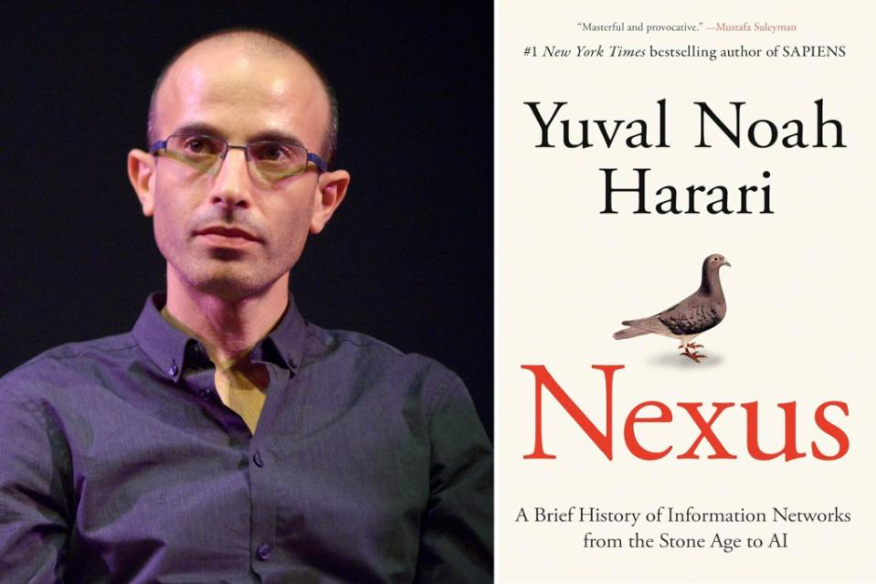
Historian Yuval Noah Harari says that we are at a critical turning point…one in which AI’s ability to generate cultural artifacts threatens humanity’s role as the shapers of history.
History will still go on, but will it be the story of people or alien "AI agents?"

Slide 66
"Right now, one thing is sure: there is something wrong with any claim to know, today, of any basic differences between the minds of men and those of possible machines."
Marvin Minsky, co-founder of the IA Lab, MIT
father of Artificial Intelligence
Minsky views the brain as a machine whose functioning can be studied and replicated in a computer, which would teach us, in turn, to better understand the human brain and higher-level mental functions. This quote is from an interview at the BBVA Frontiers of Knowledge Awards, 2014.
Notes:
The human brain contains approximately 86 billion neurons, which are connected to each other by over 100 trillion synapses. Ng and the Google fellow Jeff Dean, used an array of 16,000 processors to create a neural network with more than one billion connections. A neural network is a method in artificial intelligence (AI) that teaches computers to process data in a way that is inspired by the human brain, but it uses many different types of processes lik mimic human intelligence and human cognitive functions like problem-solving and learning. AI uses predictions and automation to optimize and solve complex tasks that humans have historically done, such as facial and speech recognition, decision-making and translation.

Slide 67
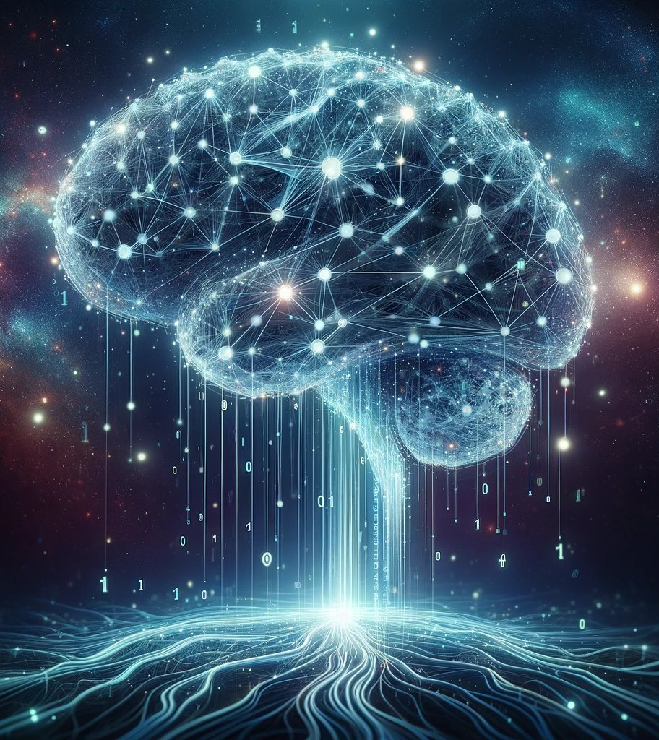
The human brain contains approximately 86 billion neurons, which are connected to each other by over 100 trillion synapses.

Slide 68
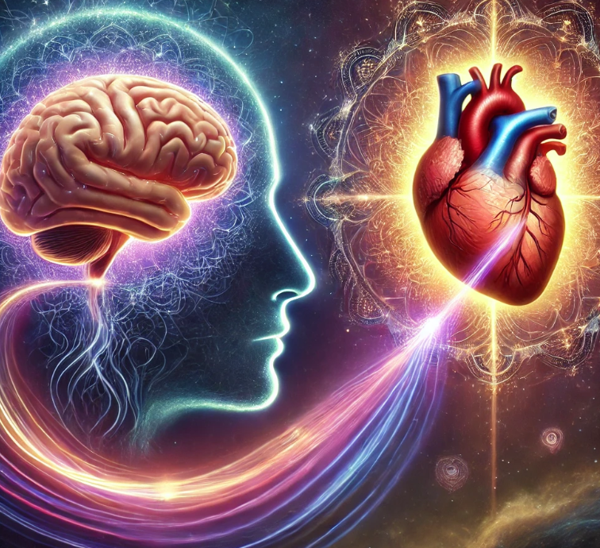
The heart sends more biochemical messages and nerve activity to the brain than the brain sends to the heart, primarily through the vagus nerve, meaning there is more signaling from heart to brain than vice versa; this is often referred to as the "heart-brain connection.” …the majority of fibers in the vagus nerves are afferent (ascending) in nature. Furthermore, more of these ascending neural pathways are related to the heart (and cardiovascular system) than to any other organ.⁽²⁾ This means the heart sends more information to the brain than the brain sends to the heart. (HeartMath Institute)
Dr. Armour, in 1991, discovered that the heart has its "little brain" or "intrinsic cardiac nervous system." This "heart brain" is composed of approximately 40,000 neurons that are alike neurons in the brain, meaning that the heart has its own nervous system. In addition, the heart communicates with the brain in many methods: neurologically, biochemically, biophysically, and energetically. (1)
Notes:
And as the researchers at HeartMath remind us there are more Yes, according to current scientific understanding, the heart sends more biochemical messages and nerve activity to the brain than the brain sends to the heart, primarily through the vagus nerve, meaning there is more signaling from heart to brain than vice versa; this is often referred to as the "heart-brain connection.".

Slide 69
References
Alshami A. M. (2019). Pain: Is It All in the Brain or the Heart?. Current pain and headache reports, 23(12), 88. https://doi.org/10.1007/s11916-019-0827-4
Ayers JW, Poliak A, Dredze M, et al. Comparing Physician and Artificial Intelligence Chatbot Responses to Patient Questions Posted to a Public Social Media Forum. JAMA Intern Med. 2023;183(6):589–596. doi:10.1001/jamainternmed.2023.1838HeartMath Institute, overview of research Science of the Heart: Exploring the role of the heart in human performance.
Accessible to large populations (Renton T, Tang H, Ennis N, et al. Web-based intervention programs for depression: a scoping review and evaluation. J Med Internet Res. 2014;16(9):e209. DOI:https://doi.org/10.2196/jmir.3147(open in a new window).
Boucher, E.M., Harake, N.R., Ward, H.E., Stoeckl, S.E., Vargas, J., Minkel, J., Parks, A.c., & Zilca, R. (2021). Artificially intelligent chatbots in digital mental health interventions: a review. Expert review of medical devices, 18(sup1), 37-49. DOI.org/10.1080/17434440.2021.201320.
Cameron Jones and Ben Bergen. 2024. Does GPT-4 pass the Turing test?. In Proceedings of the 2024 Conference of the North American Chapter of the Association for Computational Linguistics: Human Language Technologies (Volume 1: Long Papers), pages 5183–5210, Mexico City, Mexico. Association for Computational Linguistics.
Casu, M., Triscari, S., Battiato, S., Guarnera, L., & Caponnetto, P. (2024). AI Chatbots for Mental Health: A Scoping Review of Effectiveness, Feasibility, and Applications. Applied Sciences, 14(13), 5889. https://doi.org/10.3390/app14135889
Shan, R., Sarkar, S., & Martin, S. S. (2019). Digital health technology and mobile devices for the management of diabetes mellitus: state of the art. Diabetologia, 62(6), 877–887. https://doi.org/10.1007/s00125-019-4864-7
Reddy S. (2024). Generative AI in healthcare: an implementation science informed translational path on application, integration and governance. Implementation science : IS, 19(1), 27. https://doi.org/10.1186/s13012-024-01357-9
Center for Countering Digital Hate. AI and Eating Disorders study. (2023). https://counterhate.com/research/ai-tools-and-eating-disorders
Timmons, A. C., Duong, J. B., Simo Fiallo, N., Lee, T., Vo, H. P. Q., Ahle, M. W., Comer, J. S., Brewer, L. C., Frazier, S. L., & Chaspari, T. (2023). A Call to Action on Assessing and Mitigating Bias in Artificial Intelligence Applications for Mental Health. Perspectives on psychological science : a journal of the Association for Psychological Science, 18(5), 1062–1096. https://doi.org/10.1177/17456916221134490souleris, N.,m
Koutsouleris, N., Hauser, T.U., Skvortsova, V., & DeChoudhury, M. (2022). From promise to practice: towards the realisatin of AI-informed mental health care.The Lancet (British Edition), 4(11), e829-e840
Li, H., Zhang, R., Lee, Y-C., Kraut, R.E., & Mohr, D.C.(2023). Systematic review and meta-analysis of AI-based conversational agents for promoting mental health and wellbeing. NPJ Digital Medicine 6,(1), 236-236
Holohan, M., & Fiske, A. (2021). “Like I’m talking to a real person”: Exploring the meaning of transference for the use and design of AI-based applications in psychotherapy. Frontiers in Psychology, 12.
Renton T, Tang H, Ennis N, et al. Web-based intervention programs for depression: a scoping review and evaluation. J Med Internet Res. 2014;16(9):e209. DOI:https://doi.org/10.2196/jmir.3147(open in a new window).
Schueller SM, Hunter JF, Figueroa C, et al. Use of digital mental health for marginalized and underserved populations. Curr Treat Options Psych. 2019;6(3):243–255. DOI:https://doi.org/10.1007/s40501-019-00181-z

